Slide 1
SAKS_WTCH (WARP) Always key the following, visible in the invoice separator sheet:
Batch ID (68) BAT ID (69) Value/No
Client Code (68) CL CODE (69) SAKS
Scac Code (68) SCAC CODE (69) WTCH

Slide 2
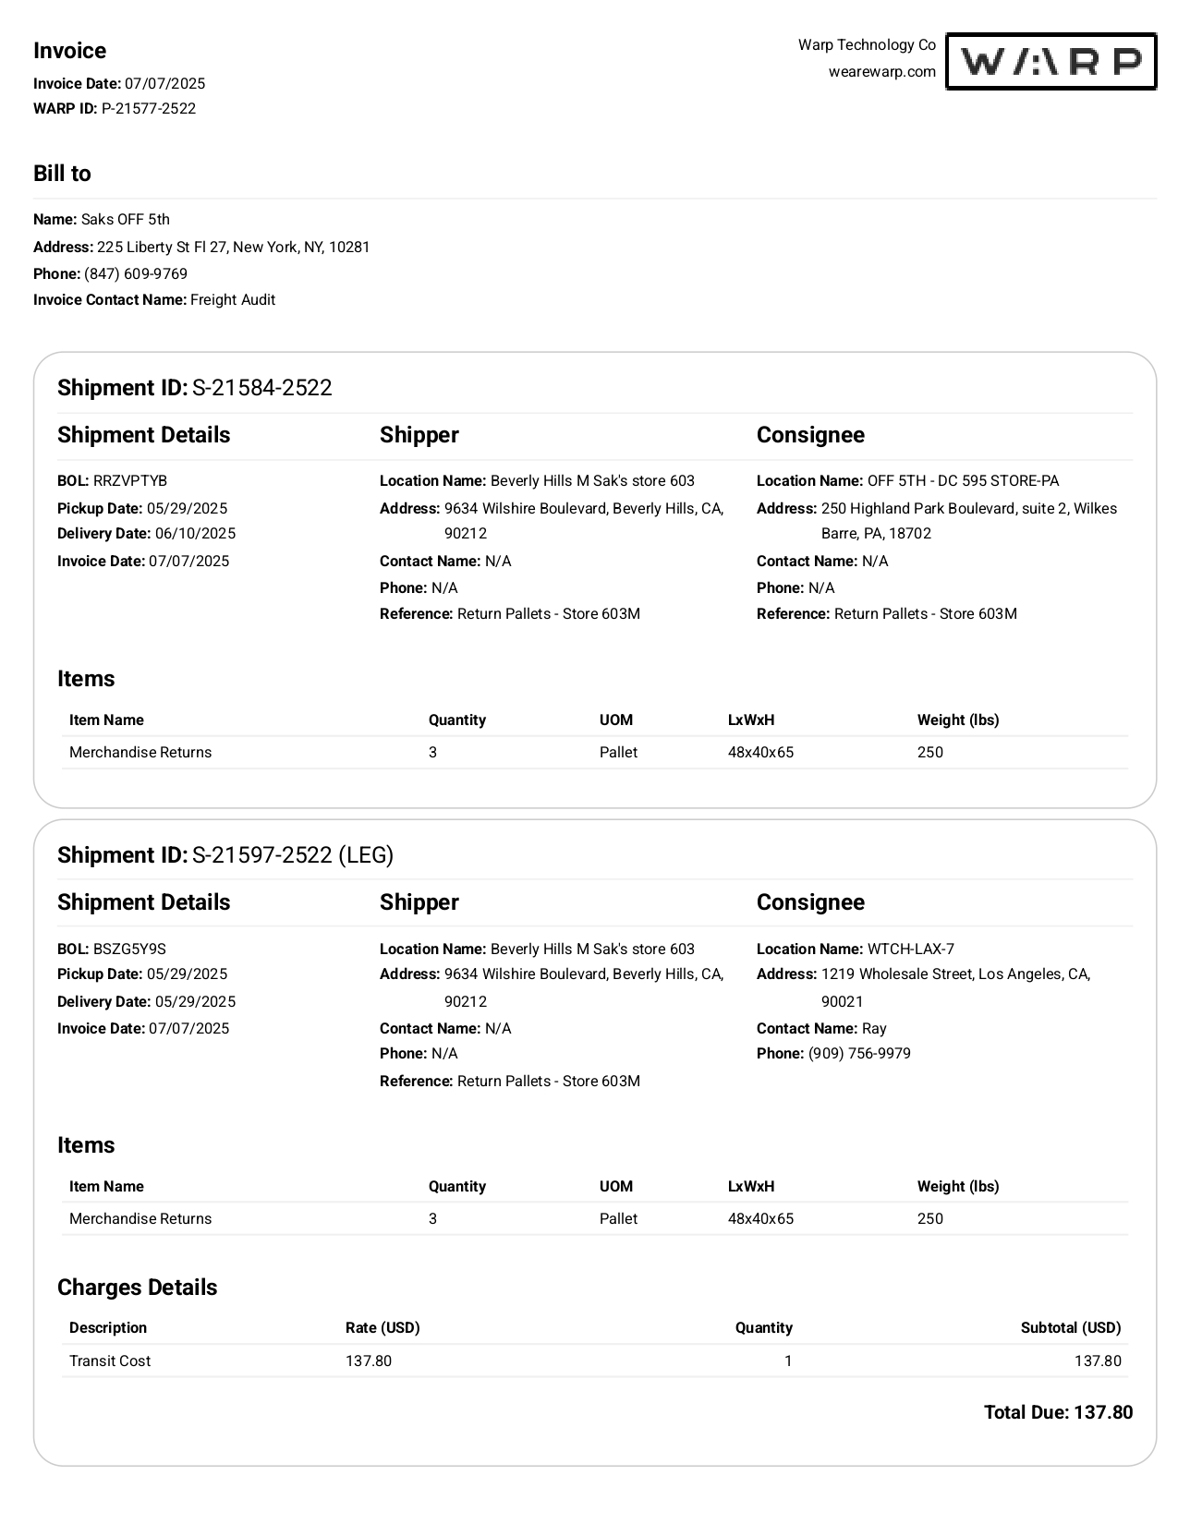
10
03
01
02
68a
01 REMIT TO
02 BILL TO
03 INV KEY
10 DATE
27 SHIPPER INV
30 CONSIGNEE INV
42 /43 ACTUAL WT/ FNCL WT
44/45 UOM
50 DIMENSION
61 PICK UP
62 DELIVERED
68a SHIPMENT ID
68b BOL
72 LINE ITEM DESC
74 LINE ITEM QTY Q
75 LINE ITEM RATE
85 LINE ITEM AMT
08/14 INV AMT/ FB AMT
09 CURR
68b
27
30
61
62
72
74
50
44/45
42/43
09
85
75
08/14

Slide 3
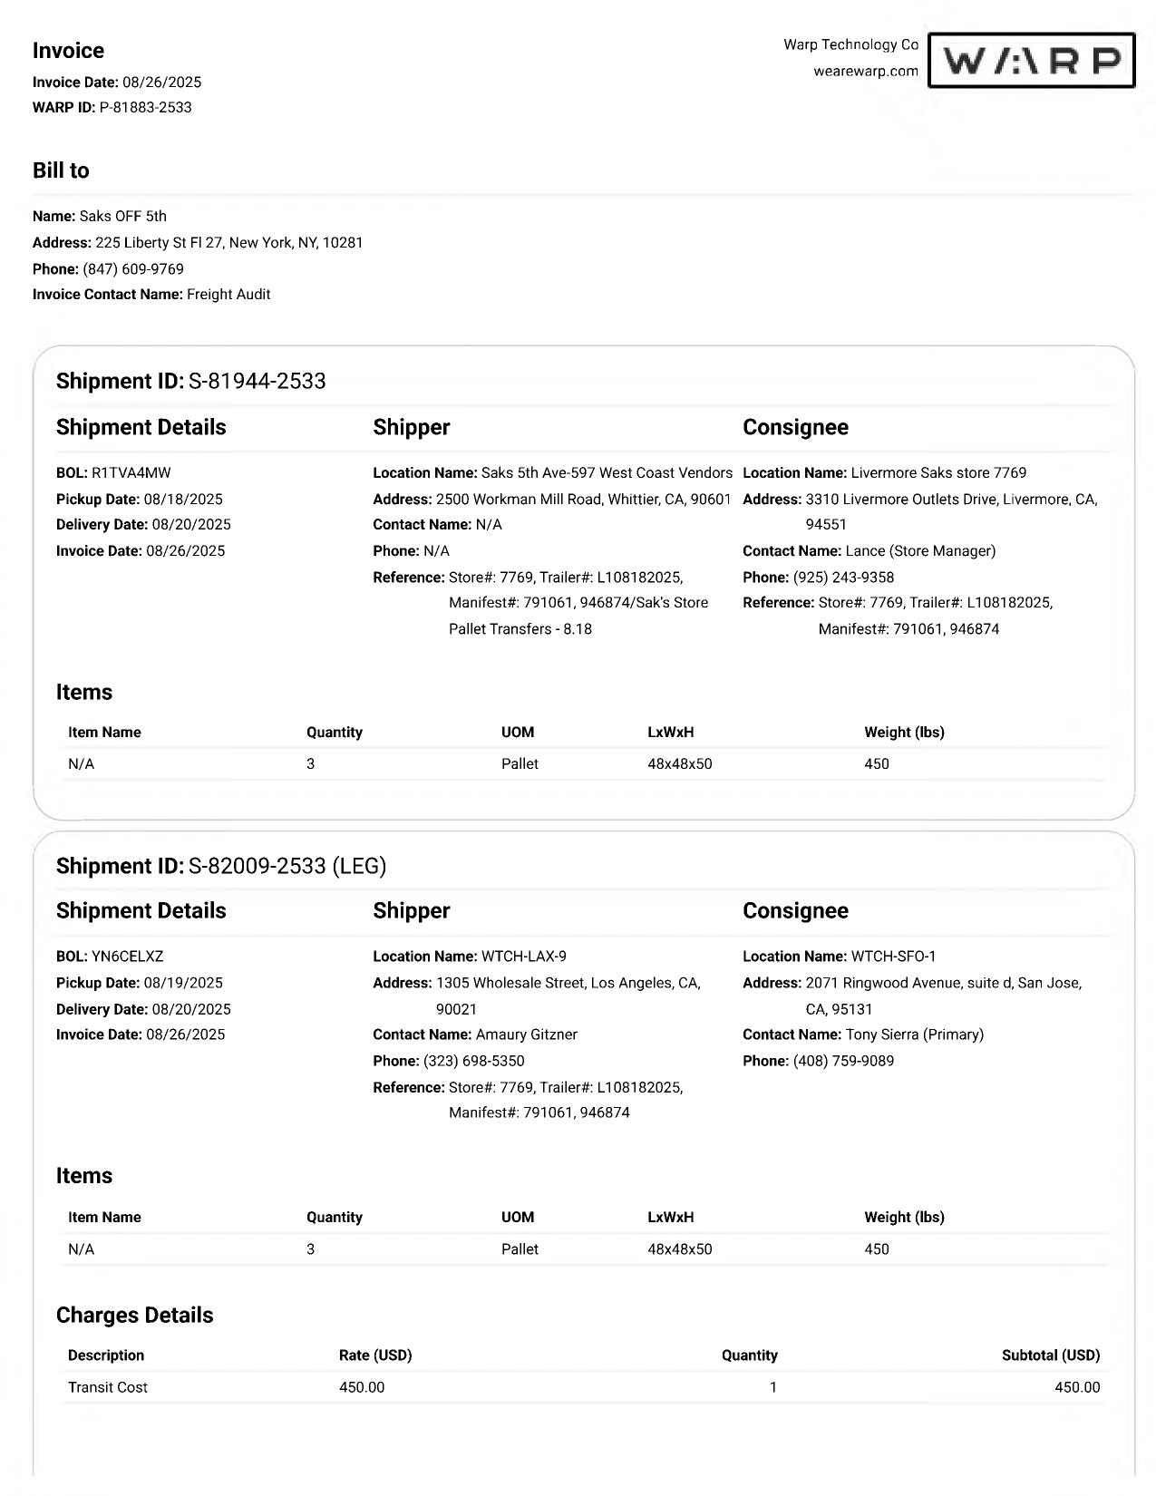
10
03
01
02
01 REMIT TO
02 BILL TO
03 INV KEY
10 DATE
27 SHIPPER INV
30 CONSIGNEE INV
42 /43 ACTUAL WT/ FNCL WT
44/45 UOM
50 DIMENSION
61 PICK UP
62 DELIVERED
68b BOL
72 LINE ITEM DESC
74 LINE ITEM QTY Q
75 LINE ITEM RATE
85 LINE ITEM AMT
09 CURR
46 PIECES
68b
27
30
61
62
72
46
50
44/45
42/43
09
74
85
75

Slide 4
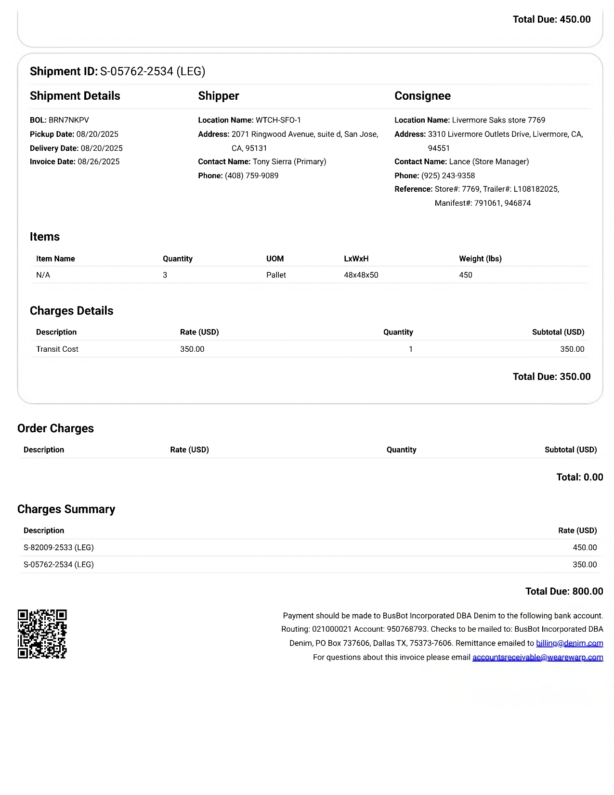
14
08 INV AMT
14 FB AMT 68a SHIPMENT ID 13 FB KEY
68a
13
08

Slide 5
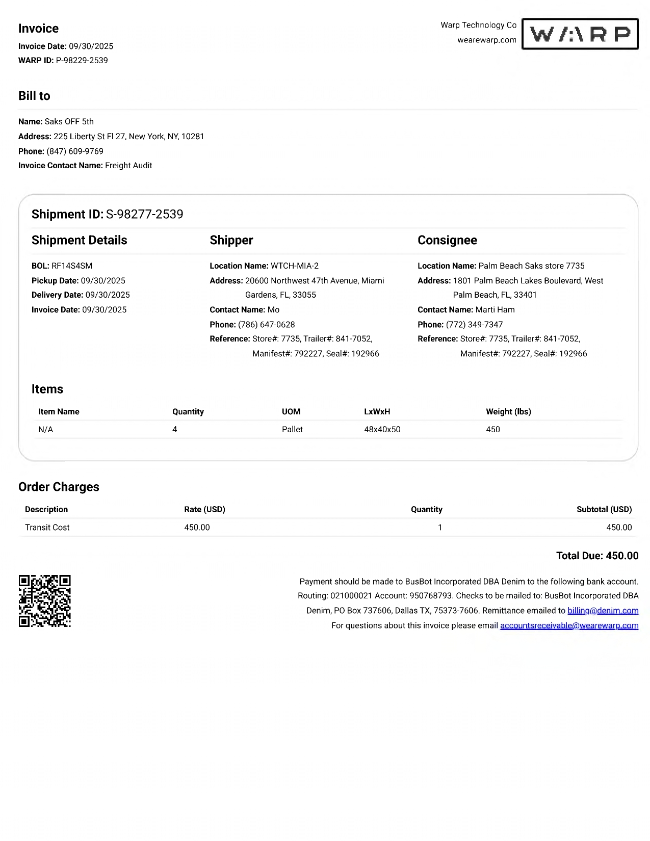
02
02 BILL TO

Slide 6
6
For Verification Table
 | NAME | DATE
DI-73922 | BABY G. VILLACARLOS | 09/25/2025
DI-74314 – Update to capture bill to (slide 5) | KHEILA MARY A. INOC | 10032025

